Slide 1
OC - Project 2
Exploratory Data Analysis
of
Educational Management Systems
World Bank
Stephane Lanchec

Slide 2
Business goal
International expansion for our online training programs company ‘academy’
Primary target audience:
Secondary to tertiary students
Workscope
Exploratory Analysis of an education management systems dataset
(Source: World Bank)
Identify countries with high customers potential
Which countries should we be settled in first
Customers potential evolution for these candidate countries

Slide 3
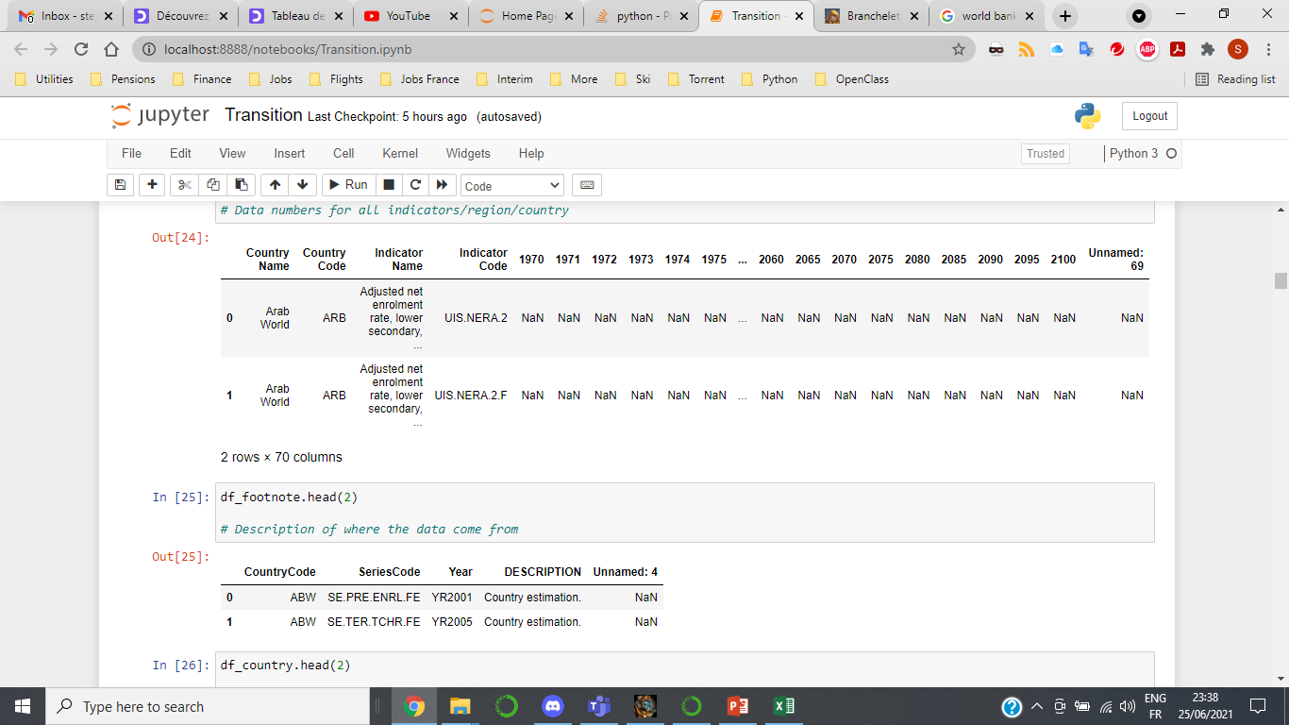
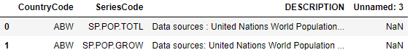
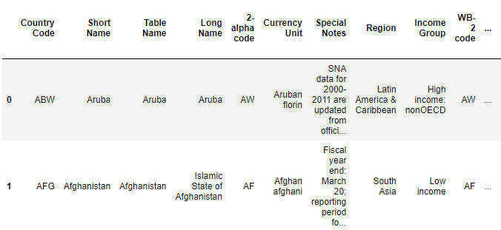
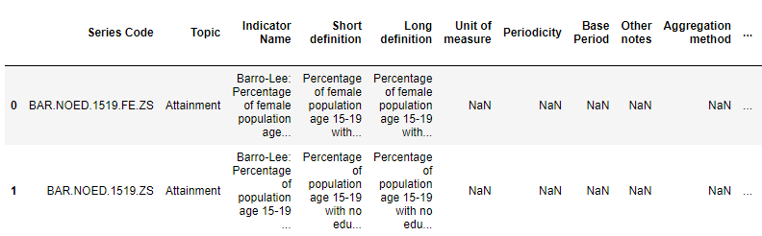
Data set available
EdStatsData.csv
Loading the data into the dataframe
df_data = pd.read_csv ("EdStatsData.csv")
df_data.head(2)
EdStatsFootNote.csv
EdStatsCountry-Series.csv
EdStatsCountry.csv
EdStatsSeries.csv

Slide 4
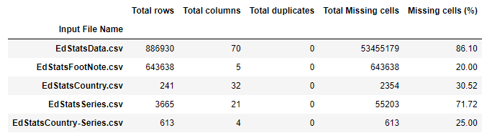
Data Set description
Input data | Description
EdStatsData.csv | Numbers by indicators/country 1970-2100
EdStatsFootNote.csv | Data source estimation
EdStatsCountry.csv | Economical country description
EdStatsCountrySeries.csv | Country codes and data source
EdStatsSeries.csv | Detailed indicators description
World Bank website | All related data

Slide 5
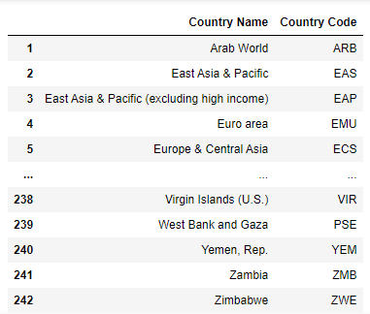
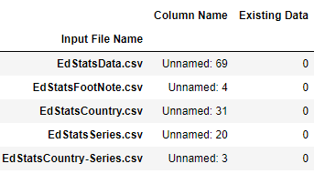
Data cleaning & arrangement
Analysis of the last column in files
Return zero data
Removal of last column
Pandas.DataFrame.drop()
First focus on EdStatsData.csv
Association Country Name-Country Code
Pandas.DataFrame.drop_duplicates()

Slide 6
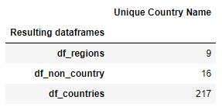
Geographic data analysis
Data processing on label ‘Country Name’
242 ‘Country Name’ divided into 3 categories
regions
non_country
countries
2 subdataframes df_regions & df_non_country
Pandas.DataFrame.isin
(Selected ‘Country Code’)
South Asia
SS Africa
N America
MENA
Latin America
E Asia Pacific
Europe & Central Asia…
High income
Low & Middle income
Arab World
Low income
Lower middle income
HIPC
World…
Afghanistan
Zimbabwe
.
.
.
.
.
1 subdataframe df_countries
~Pandas.DataFrame.isin
(Selected ‘Country Code’)

Slide 7
Data cleaning phases – Indicators choice
Number of Indicators
Timeframe reduction from 2000 to 2015 only
3665
1st Phase
Indicators availability: Choice by filter exclusion
2nd Phase
Semantic analysis: Choice by keywords exclusion
3rd Phase
Indicators hand picked: Choice by inclusion
“Pandas.DataFrame.isin()” amongst “Indicators Code”
“Pandas.DataFrame.dropna(thresh=filter)” 60%
“~Pandas.Series.str.contains()” amongst “Indicators Name”
217
136
Statistical analysis on 6 indicators
6

Slide 8
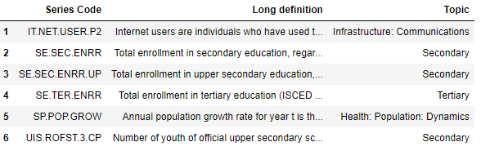
Indicators list
Internet
users
Students enrolment
secondary
tertiary
Population growth
Unemployment
Indicators dependence

Slide 9
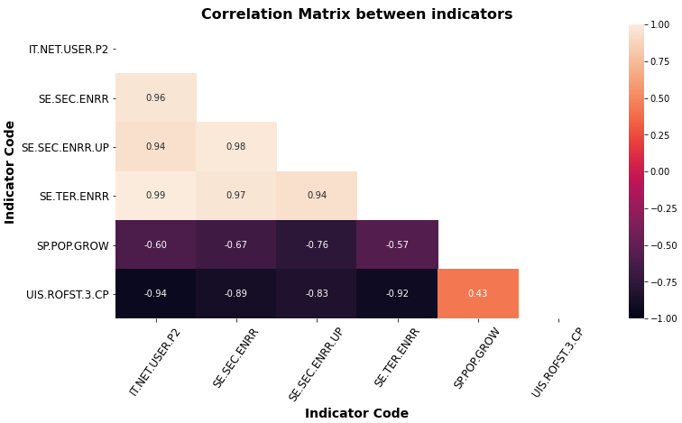
Correlation Matrix Heatmap
IT.NET.USER: Internet users
SE.SEC.ENRR: Enrolment secondary
SE.SEC.ENRR.UP: Enrolment upper secondary
SE.TER.ENRR: Enrolment tertiary
UIS.ROFT.3.CP: Out-of-school drop rate secondary
SP.POP.GROW: Population growth
Strong positive correlation between Internet users and students enrolment in secondary-tertiary
Strong negative correlation between out-of-school drop rate & students enrolment
No linear correlation between out-of-school drop rate in upper secondary & population growth

Slide 10
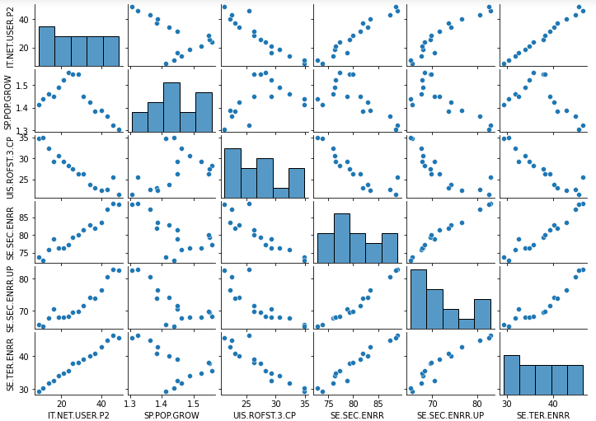
Bivariate Analysis
IT.NET.USER: Internet users
SE.SEC.ENRR: Enrolment secondary
SE.SEC.ENRR.UP: Enrolment upper secondary
SE.TER.ENRR: Enrolment tertiary
UIS.ROFT.3.CP: Out-of-school drop rate secondary
SP.POP.GROW: Population growth

Slide 11
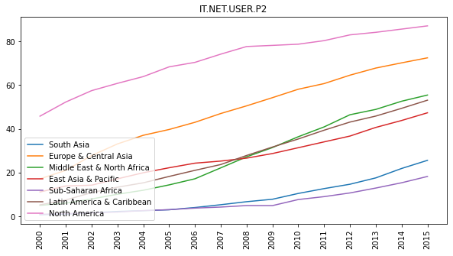
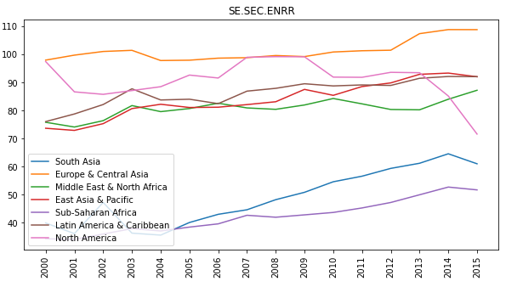
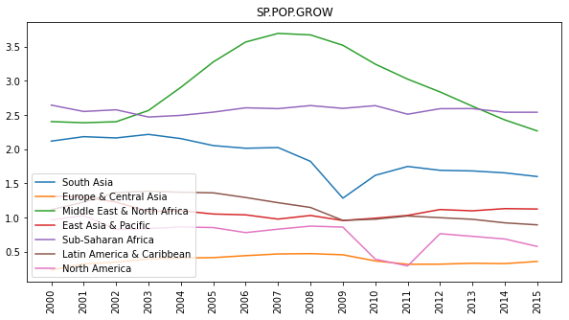
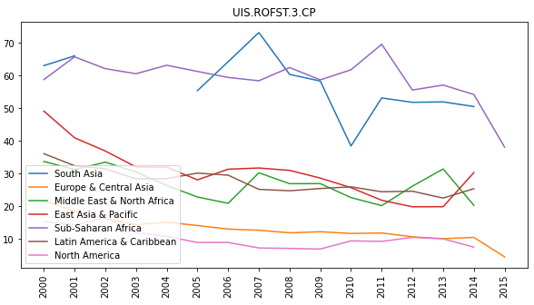
Indicators trends by regions
Last value
Median
Internet users
Secondary
students
enrolment
Mean
Median
Population
growth
Out-of-school rate
Upper secondary

Slide 12

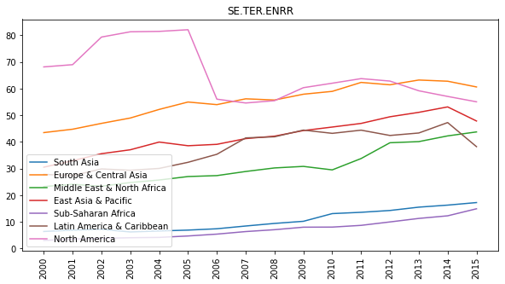
Indicators trends & averaging method
Median
Upper
secondary
students
enrolment
Median
Tertiary
students
enrolment
Indicator Code | Description | Method | Trend
IT.NET.USER.P2 | Internet users | Last value | Linear increase
SP.POP.GROW | Population growth | Mean | Fluctuations
UIS.ROFST.3.CP | Out-of-school rate sec. | Median | Weak linear
SE.SEC.ENRR | Secondary students | Median | Weak linear
SE.SEC.ENRR.UP | Upper Sec. students | Median | Weak linear
SE.TER.ENRR | Tertiary students | Median | Weak linear

Slide 13
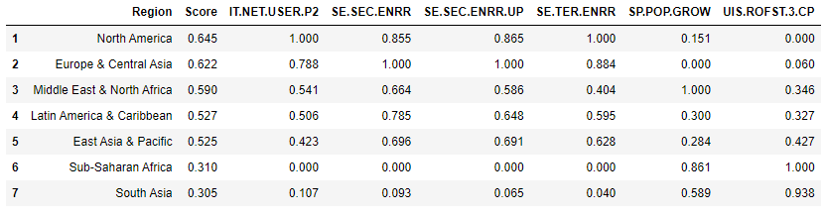
Candidates regions
Europe & Central Asia and North America have low population growth & low out-of-school drop rate but high enrolment rates (highest internet users)
Latin America, East Asia & MENA have an average internet users percentage, average secondary & tertiary enrolment
South Asia & Sub-Saharan Africa have low internet users and students enrolment

Slide 14
Potential for candidates regions
 | Europe & CA | North America | Latin America | East Asia Pacific | MENA | South Asia | SS Africa
IT users | High | High | Medium | Medium | Medium | Low | Low
Sec. enr. | High | High | High | High | Medium | Low | Low
Up sec. enr. | High | High | High | High | Medium | Low | Low
Ter. Enr. | High | High | Medium | Medium | Medium | Low | Low
Out-of-school | Low | Low | Medium | Medium | Medium | Low | High
Pop. growth | Low | Low | Medium | Medium | High | Medium | High
High potential
Short - Middle term
High potential
Middle - Long term
Low potential
Short & Long term
* High/Medium/Low: Strength of the indicators/regions for a potential expansion

Slide 15
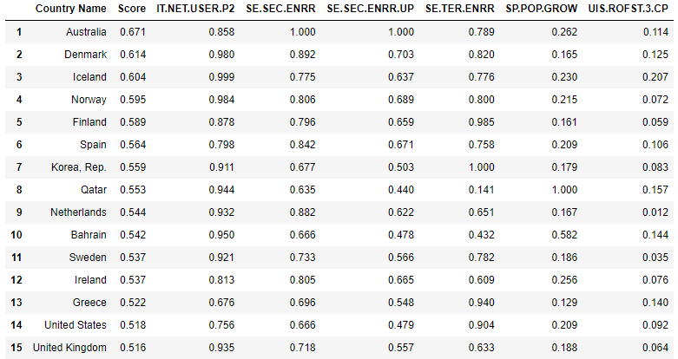
Candidates countries
Internet
users
Enrolment
Upper secondary
Population
growth
Enrolment
secondary
Enrolment
tertiary
Out-of-school
rate secondary

Slide 16
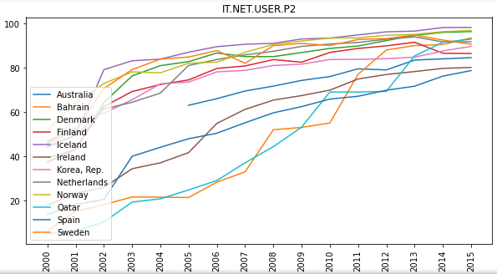
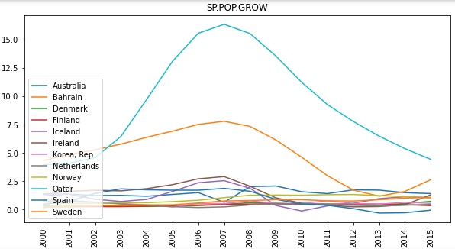
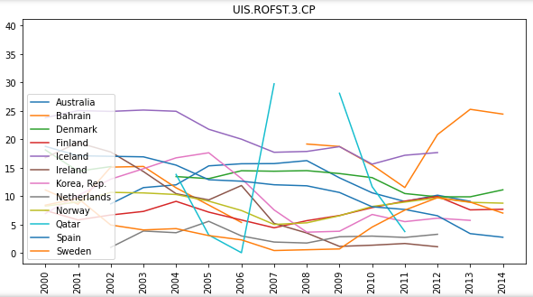
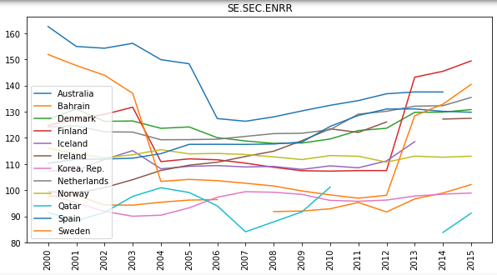
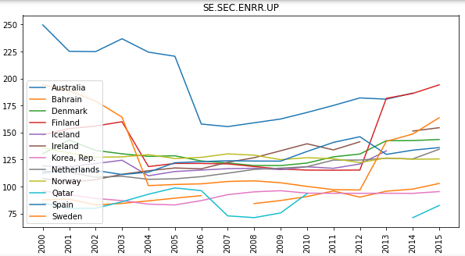
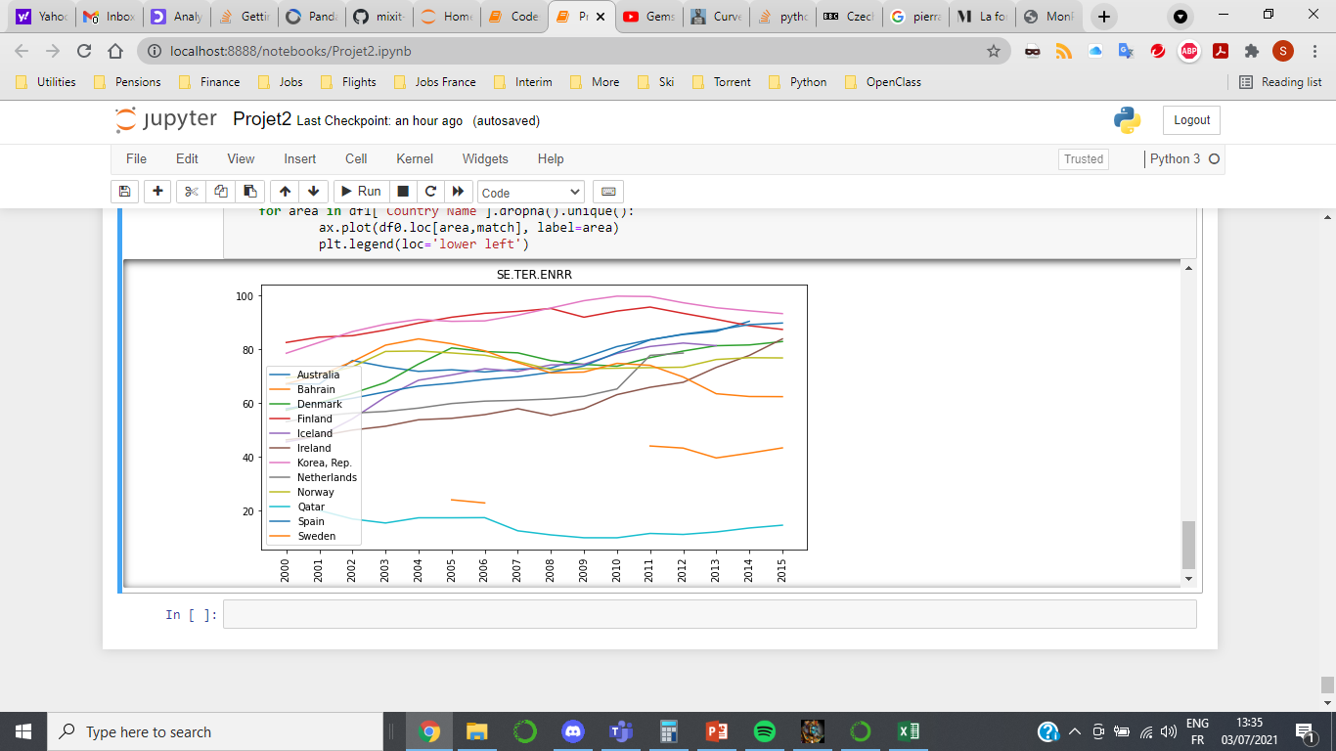
Indicators impact on countries
Internet users
Population growth rate
Out-of-school drop rate secondary
Enrolment rate secondary
Enrolment rate upper secondary
Enrolment rate tertiary

Slide 17
Discussions
Internet users is an important indicator in the short term but will have a decreasing impact in the long term for most of the countries as internet availability keeps increasing (trends are continuously increasing until they reach ~100%)
Enrolment rate in secondary and upper secondary are important factors
Increases slightly, a drop in trend would mean students wouldn’t have the basics & maturity to follow an online training program
Enrolment rate in tertiary is subjective
Large pool of candidate students in tertiary available
Countries have good universities
Out-of-school drop rate in upper secondary schools decreases inversely to the enrolment rate in tertiary
Population growth remains roughly constant for the top 10 countries
To be noted that having the necessary infrastructure and access is not enough to ensure the efficient online delivery of education.

Slide 18
Conclusions
A list of potential candidate countries to expand our business has been defined based on our choice of indicators
In order to access a maximum of students, the countries with the most potential amongst our 15 top candidates are (higher population countries):
AUSTRALIA SPAIN SOUTH KOREA UNITED STATES UNITED KINGDOM
Population growth rate in these countries are low (which gives the opportunity to pursue education & careers especially for women) and indicators trends in school enrolment show good signs to keep growing
Encouraging signs in the long term from countries in Latin America & East Asia/Pacific will have to be monitored
We do not recommend expanding in countries from Sub-Saharan Africa and South Asia as indicators scorings are quite low despite improvements since 2010

Slide 19
Acronyms
Gini index: Measure of the distribution of income across a population
EGRA: Oral assessment of the most basic foundation skills (early grades)
PIRLS: Trends in student achievement in mathematics, science, and reading
PISA: Assessment that measures 15-year-old students' reading, mathematics, and science
TIMSS: Trends data on the mathematics and science achievement of U.S. students compared to that of students in other countries
DHS: Collect, analyse accurate and representative data on population, health, HIV, and nutrition
SACMEQ: Assessment on mathematics & reading proficiency
PASEC: Mean performance on different subject, grades distribution
LLECE: Mean performance on different subject, grades distribution
SABER: Produce comparative data and knowledge on education policies and institutions

